Slide 1



Introducing PathSimR – a versatile tool for modelling pathway capacity in NHS organisations
Richard Wood
Ben Murch
Josh Tyler
Christos Vasilakis
@BNSSGAnalytics
@ProfChristosV

Slide 2
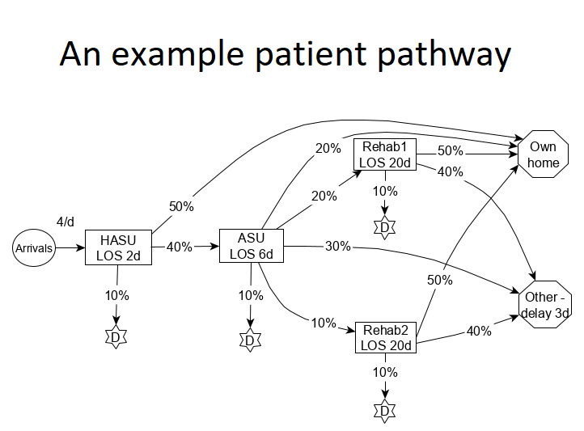
Setting the scene
Knowing how much capacity to commission is one of the most important questions facing healthcare planners
Pitch too high and waste valuable resources, too low and risk discharge delays, poor patient outcomes and negative experience
Given that much healthcare involves multiple points of contact along a pathway, capacity planning can be a complex task

Slide 3
Outline
Current practice
Vision and objective
Modelling requirements
The simulation engine
The user interface (case study)

Slide 4
Planning in silos
A common criticism of the NHS is its thinking and planning “in silos”
For capacity planning, it is no doubt easier to model individual units or services at a time
But most care takes place as part of patient pathways, which cut across many points of delivery (GP, OP, IP, CS)

Slide 5
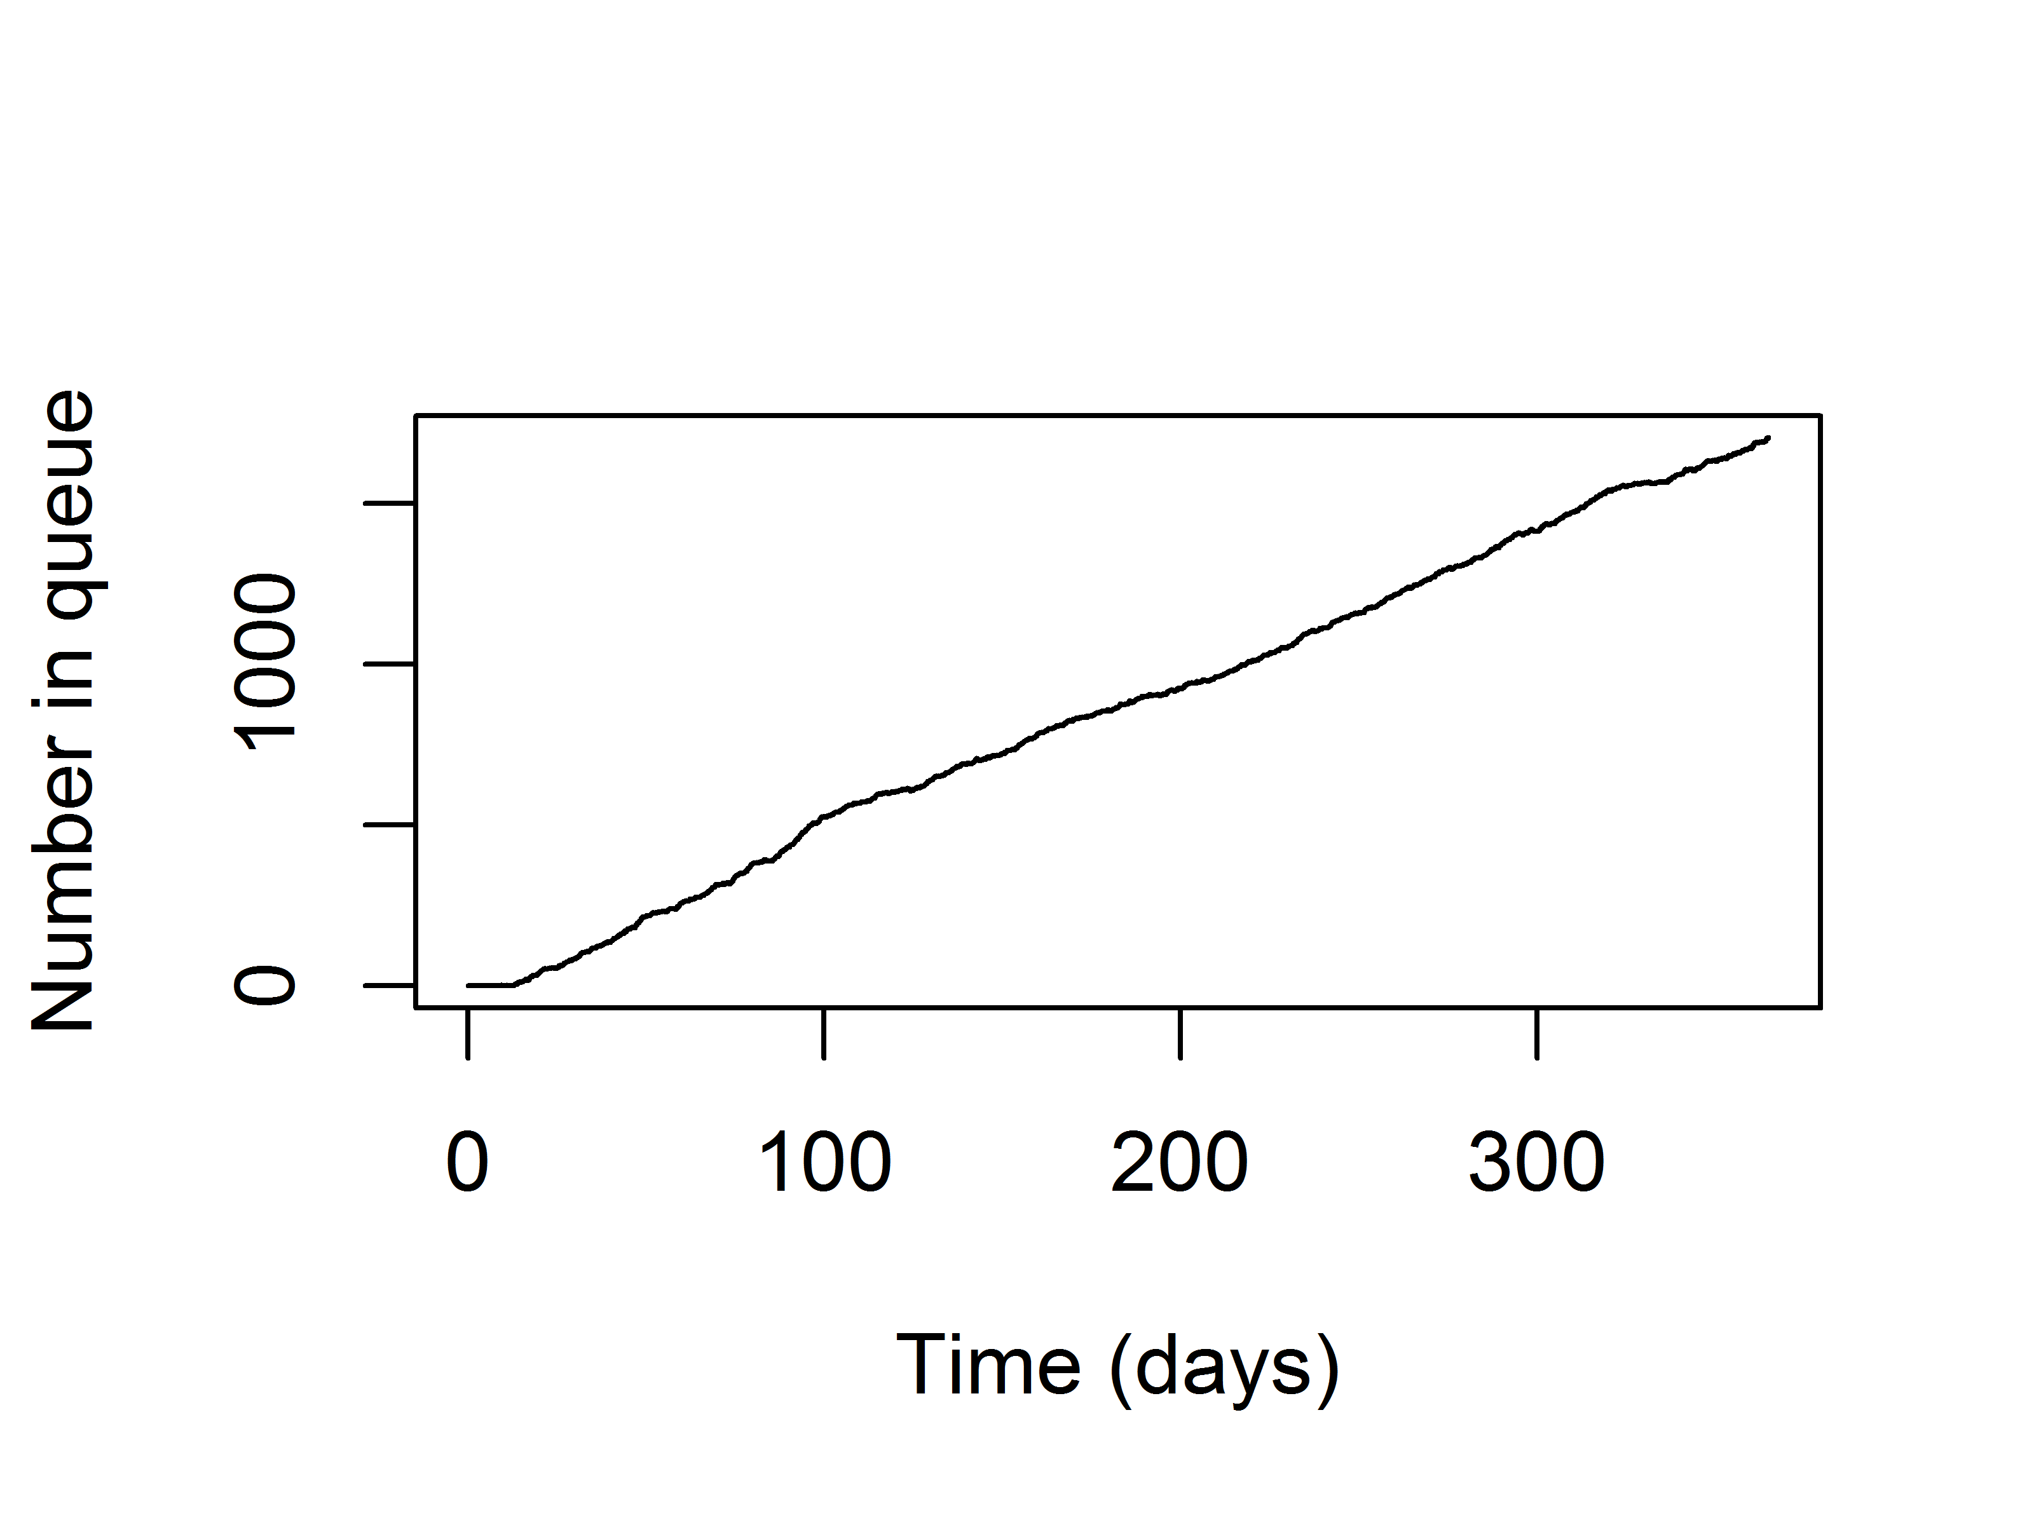
Pathway averages
Averages-based methods remain commonplace
These will always under-estimate capacity requirements, by up to 40%
Unsustainable – the effect of planning by averages

Slide 6
Outline
Current practice
Vision and objective
Modelling requirements
The simulation engine
The user interface (case study)

Slide 7
The vision
Sustainable patient pathways promoted through a good understanding of impacts on costs, resources and waiting times
The objective
To develop an engaging user tool that can be used to support decisions on capacity requirements along a flexible range of pathways containing both outpatient clinics and bedded units

Slide 8
Utility
How many beds are needed such that average ward occupancy is 85%?
How many OP clinics are needed to ensure 92% are seen within 18wks?
What is the optimal level of blocking?
What would happen to waiting times if demand increases (but capacity doesn’t)?
What would be the optimal allocation of capacity along a pathway to ensure lowest cost ceteris paribus?

Slide 9
Outline
Current practice
Vision and objective
Modelling requirements
The simulation engine
The user interface (case study)

Slide 10

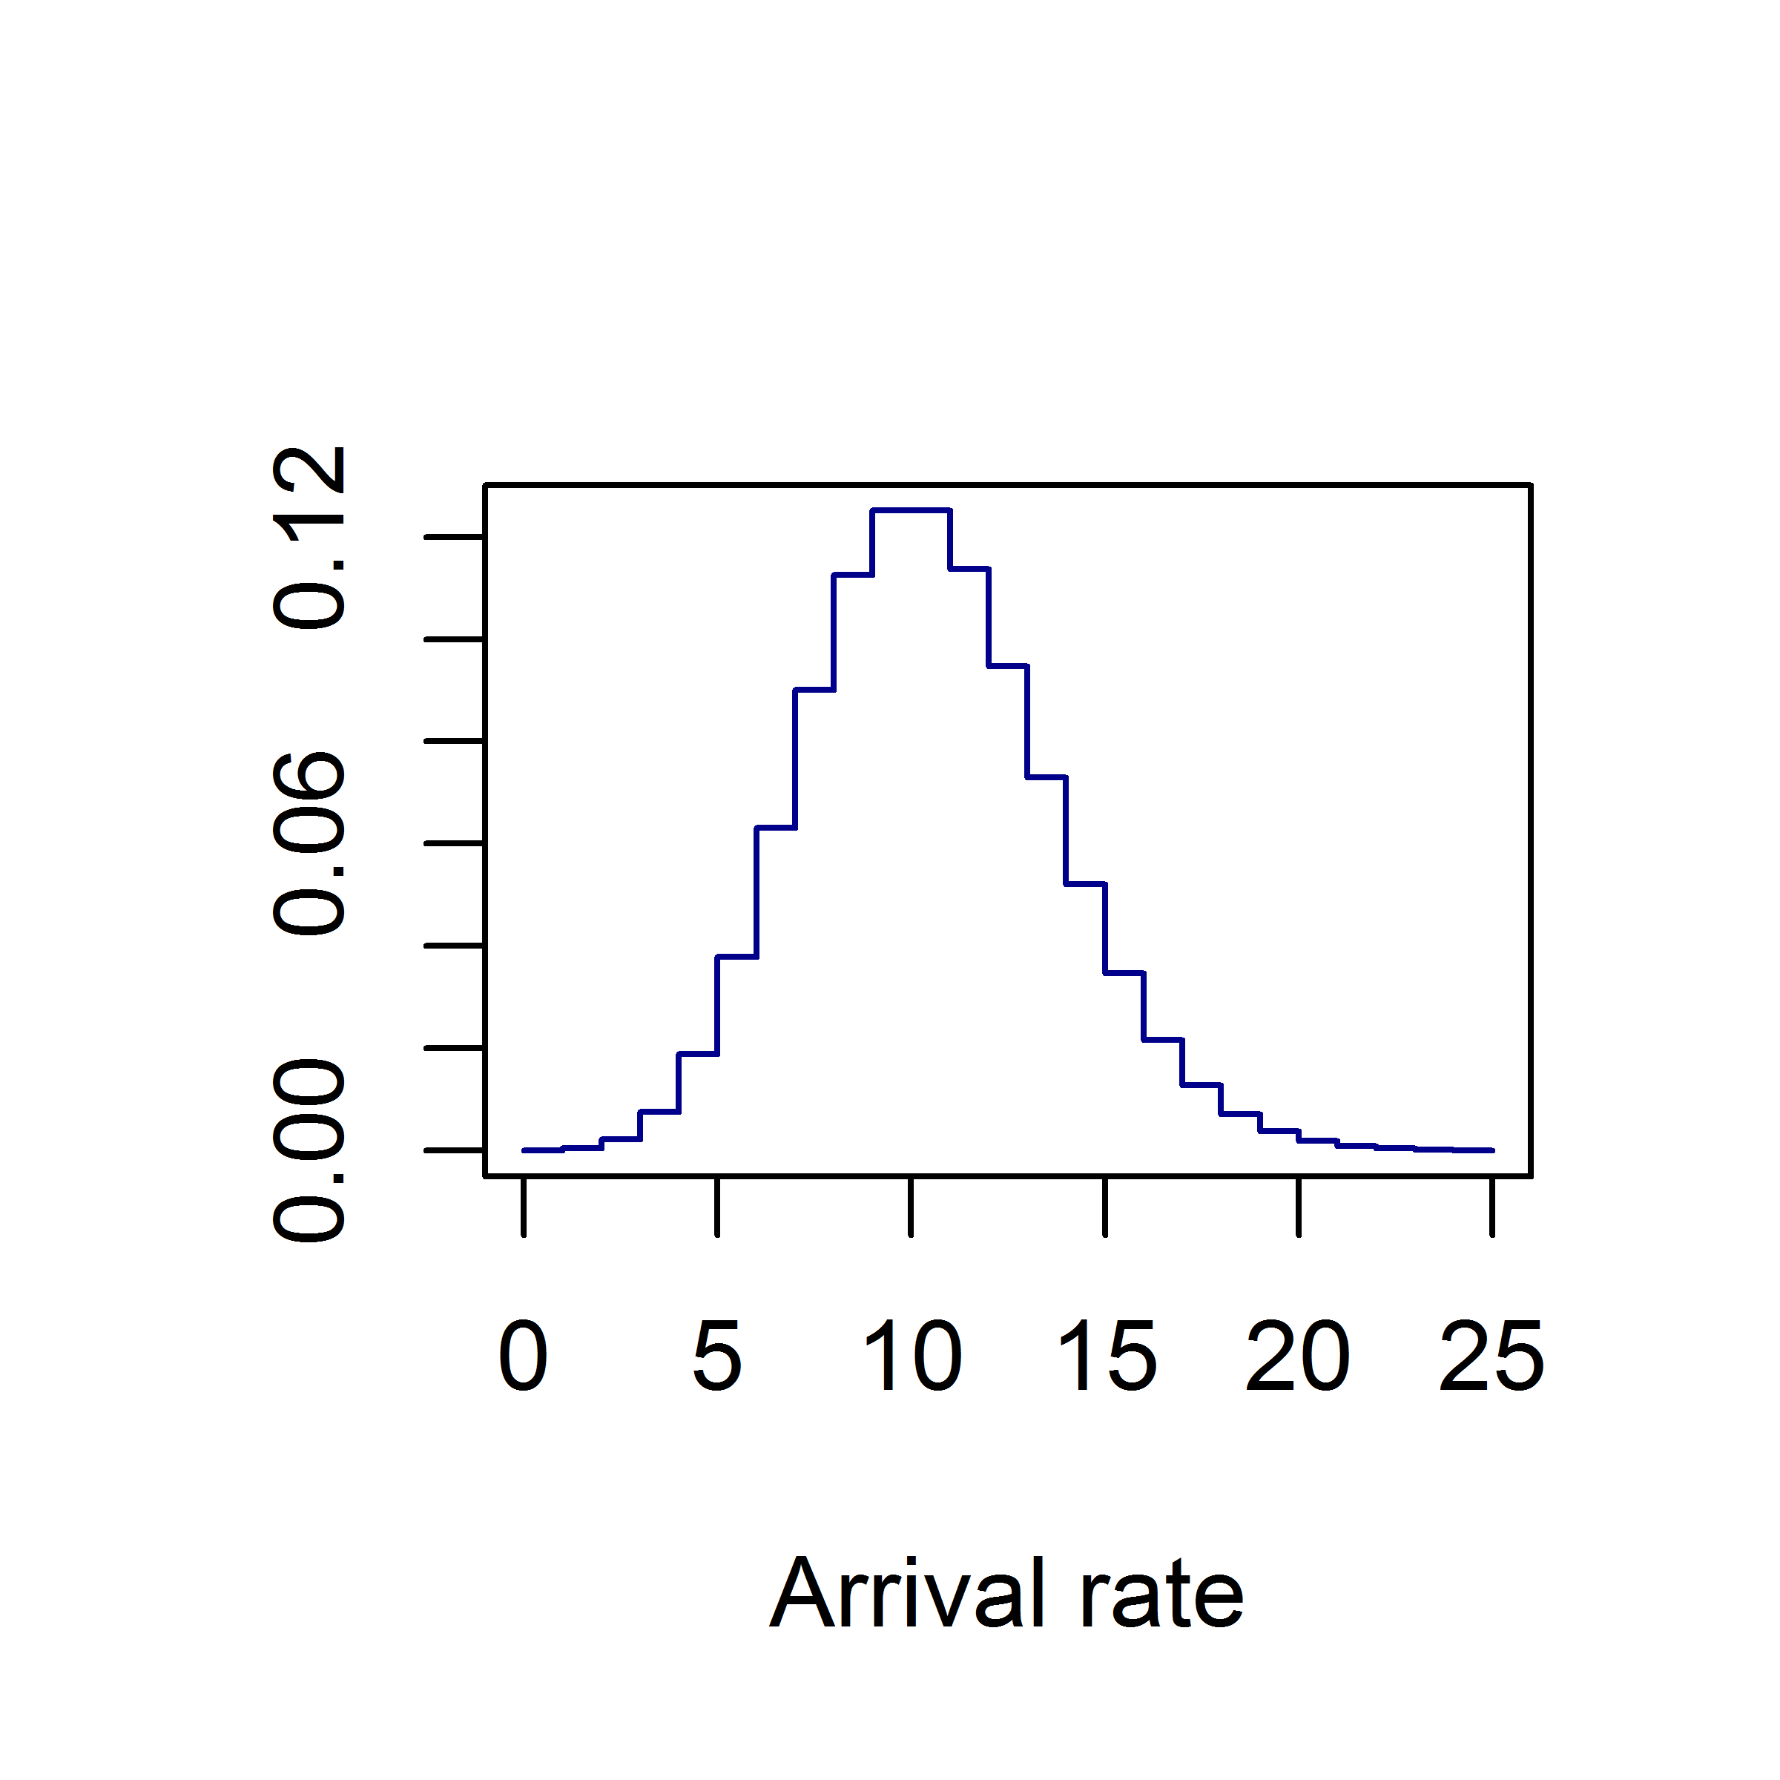
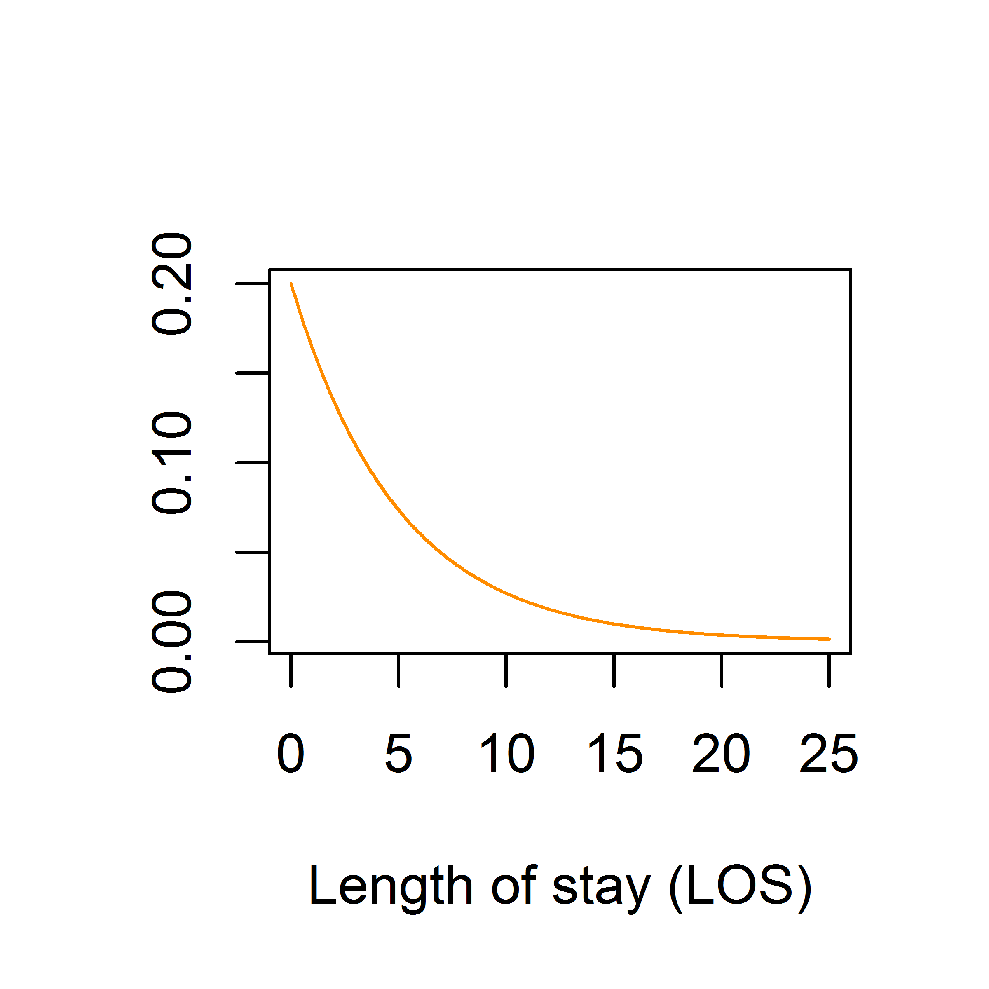
Need to appreciate variability
Simple averages-based approaches will not work
These substantially under-estimate capacity requirements
E.g.
Gives 10 × 5 = 50 bed requirement
With some reasonable variability, yields:
Arrival
Q
Discharge
10/d
LOS = 5d
Need a stochastic model

Slide 11

Take account of discharge delays
Service channels can always be in use
Outpatient pathway
Patient bed LOS
Consultation
Procedure
Length of stay
Q
Q
Referral
Home
Patients wait out of hospital
Bedded pathway
Patient undergoing meaningful treatment
Patient not making best use of resource
Acute unit
Rehab unit
Emerg.
arrival
Social care
Active
Blocked
Patients wait in hospital
Service channels can be
“blocked”
Dependent on age, diagnosis, severity, etc
Dependent on downstream capacity

Slide 12
Outline
Current practice
Vision and objective
Modelling requirements
The simulation engine
The user interface (case study)

Slide 13
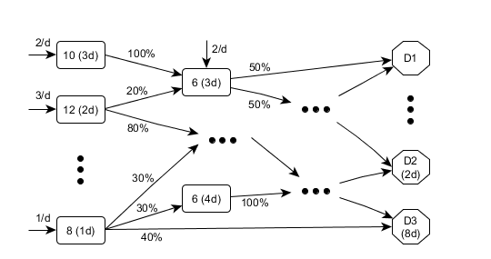
Model parameters
The model needs flexibility to account for various patient pathways
These are defined by the nodes, arrivals, flows, and discharge delays

Slide 14

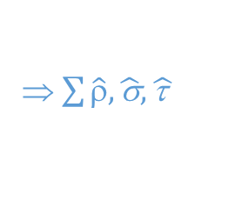
Discrete event simulation
1. A number of runs are performed
2. Each run simulates pathway events over a fixed period of time
3. Different random numbers used to sample from distributions
1
⇒ ρ₁,σ₁,τ₁
2
⇒ ρ₂,σ₂,τ₂
3
⇒ ρ₃,σ₃,τ₃
⇒ $\sum{\hat{ρ},\hat{\text{σ}},\hat{\text{τ} }}$
6. Costs and performance measures averaged over all runs
n
⇒ ρ_{n},σ_{n},τ_{n}
i.e. Monte Carlo method
4. One run is effectively one way in which a year could play out
5. Many runs performed in order to appreciate the many possible ways

Slide 15
Outline
Current practice
Vision and objective
Modelling requirements
The simulation engine
The user interface (case study)

Slide 16
Stroke centralisation
Requires a hyper-acute stroke unit (HASU) as single “front door”
Shown to improve patient outcomes
Promoted in the NHS Long Term Plan
Our ask is to determine the capacity requirements for bedded units along such a centralised stroke pathway in the BNSSG system
HASU

Slide 17
Illustrative centralised pathway
Hyper-acute stroke unit
Acute stroke unit
Rehabilitation
Emergency
arrival
Social care
Own home
Patients wait in hospital

Slide 18
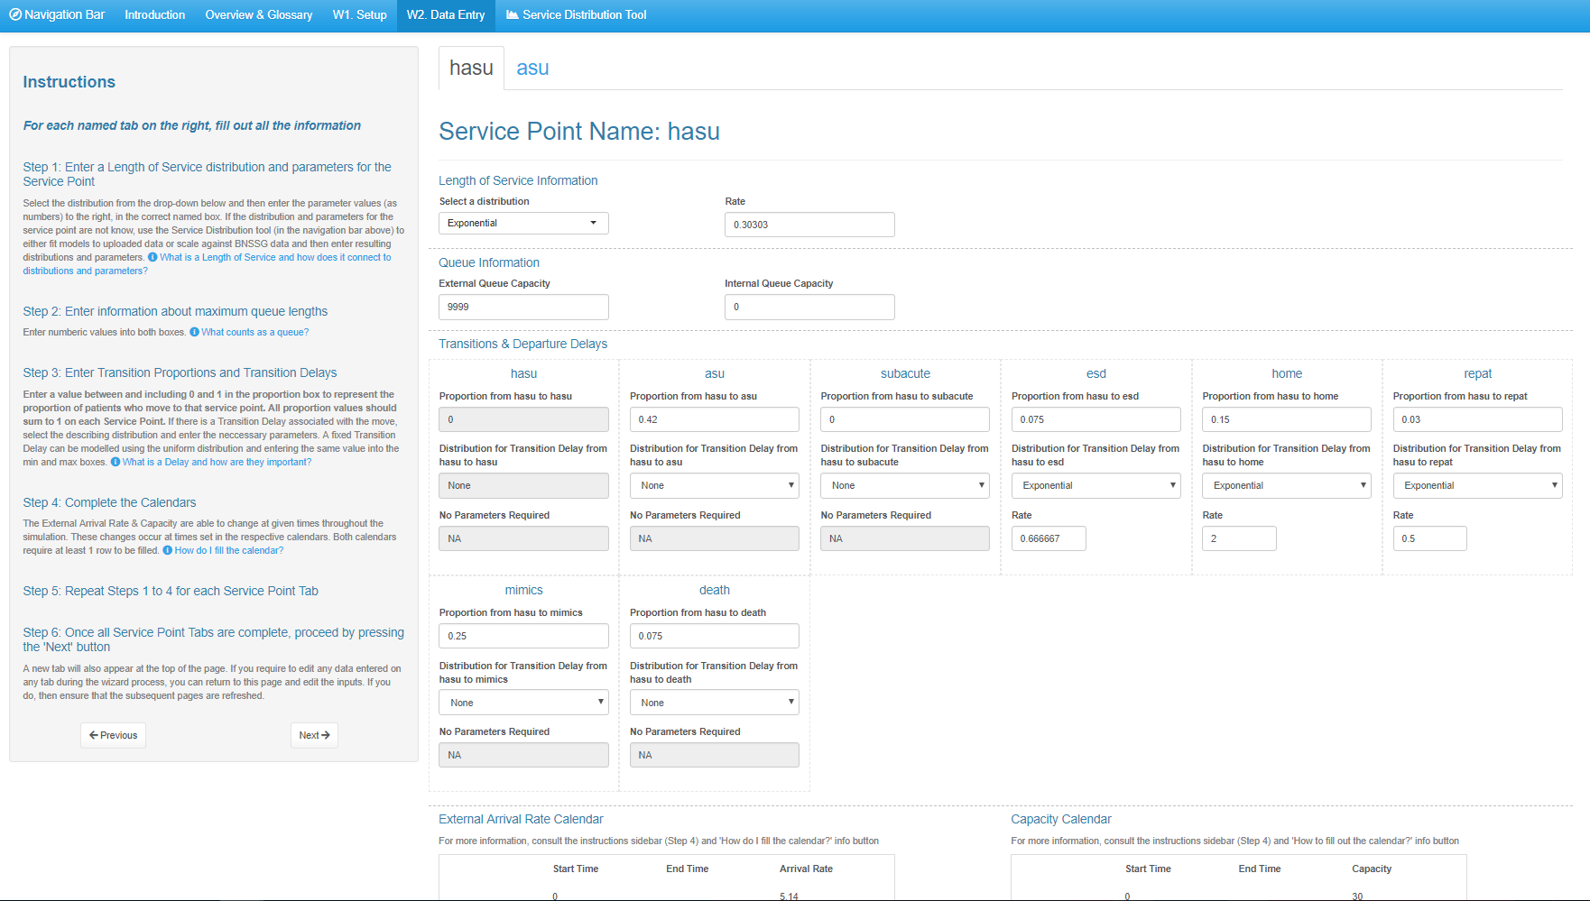
Inputting via PathSimR wizard
Service point
Length of stay
Transition rate and prescribed delay to exit
Arrival rate and capacity
Notes:
Annotated screenshot of PathSimR wizard being configure for simple 1HASU – 1ASU pathway

Slide 19
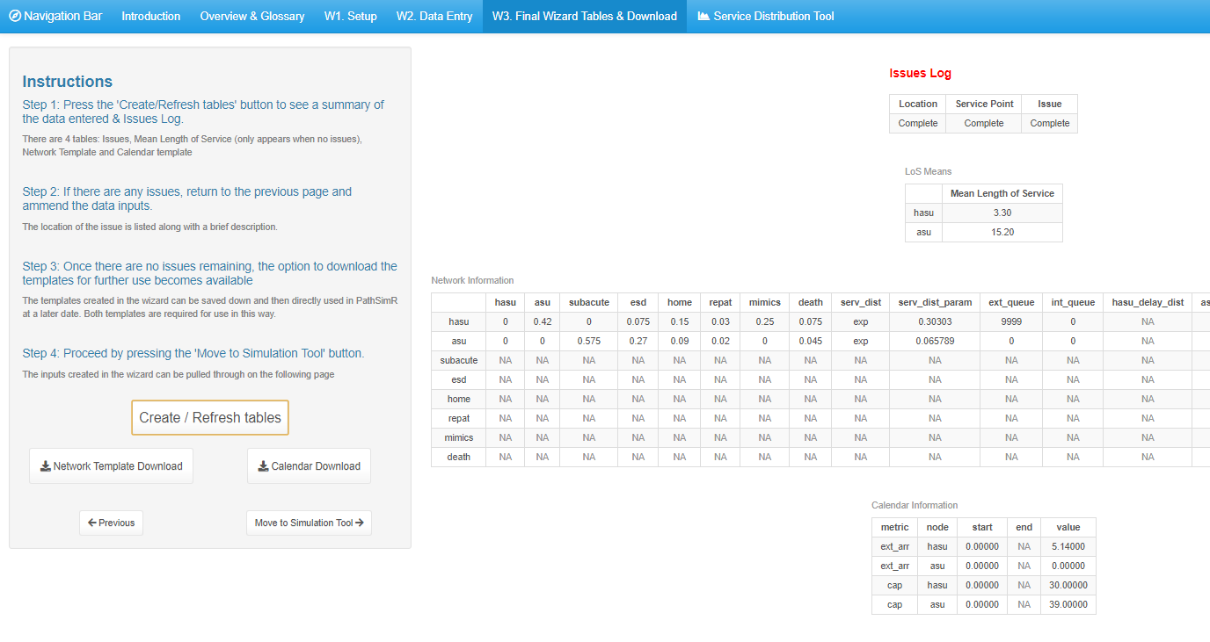
Checking inputs
Input errors (and where to find them)
Lengths of stay
Download and save inputs
Transition matrix and service parameters
Arrivals and capacity
Notes:
Annotated screenshot of input checking screen (i.e. with the pathway picture on it, complete with parameters)

Slide 20
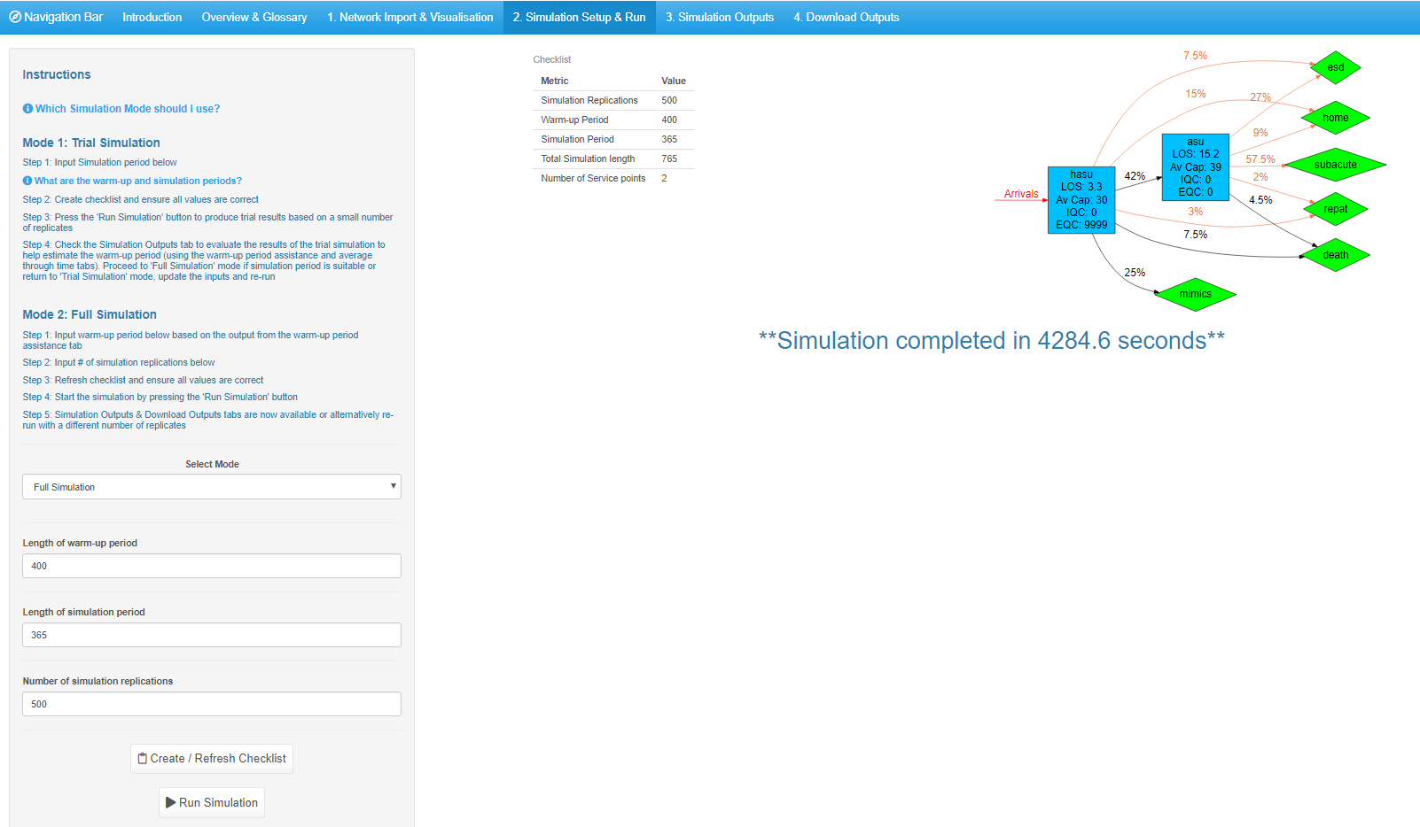
Setting up the simulation
Check simulation run settings and network specification
Choose warm up, run time, and replications
Press “Go”
Notes:
Annotated screenshot showing global option config (i.e. sim length, # runs, etc)

Slide 21
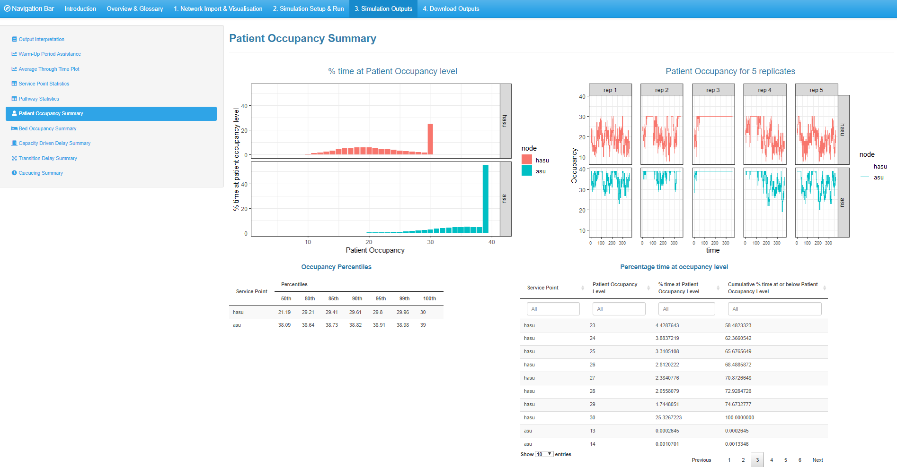
Inspecting the results
Choice of outputs (node, patient, plots, tables, occupancy, queue, etc.)

Slide 22
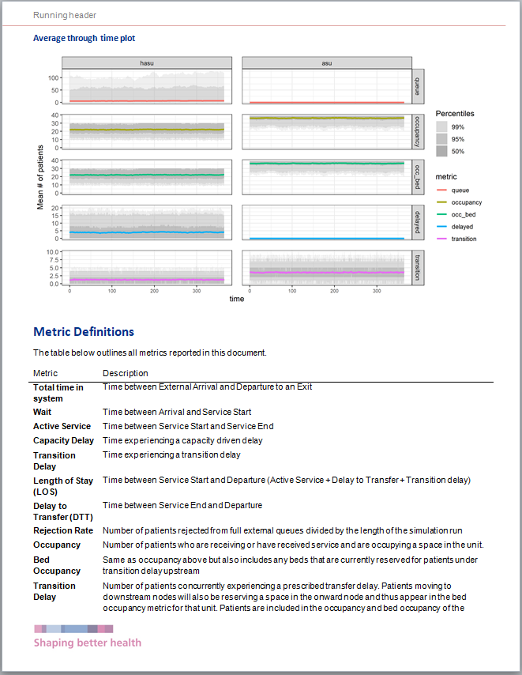
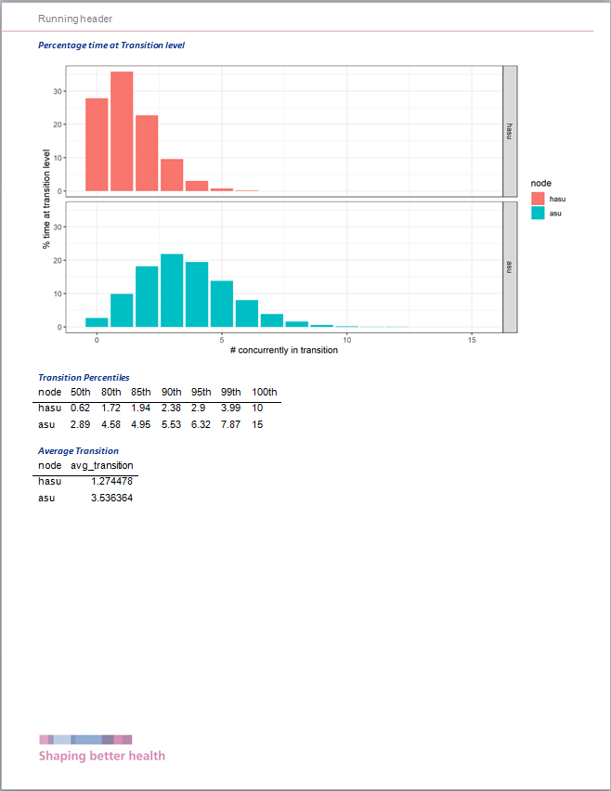
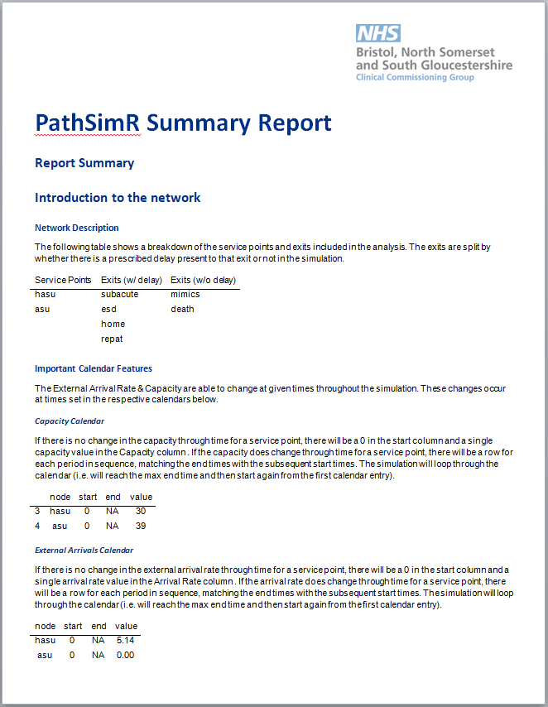
Automated output reporting
Notes:
A few pages feathered on top of each other from markdown report

Slide 23
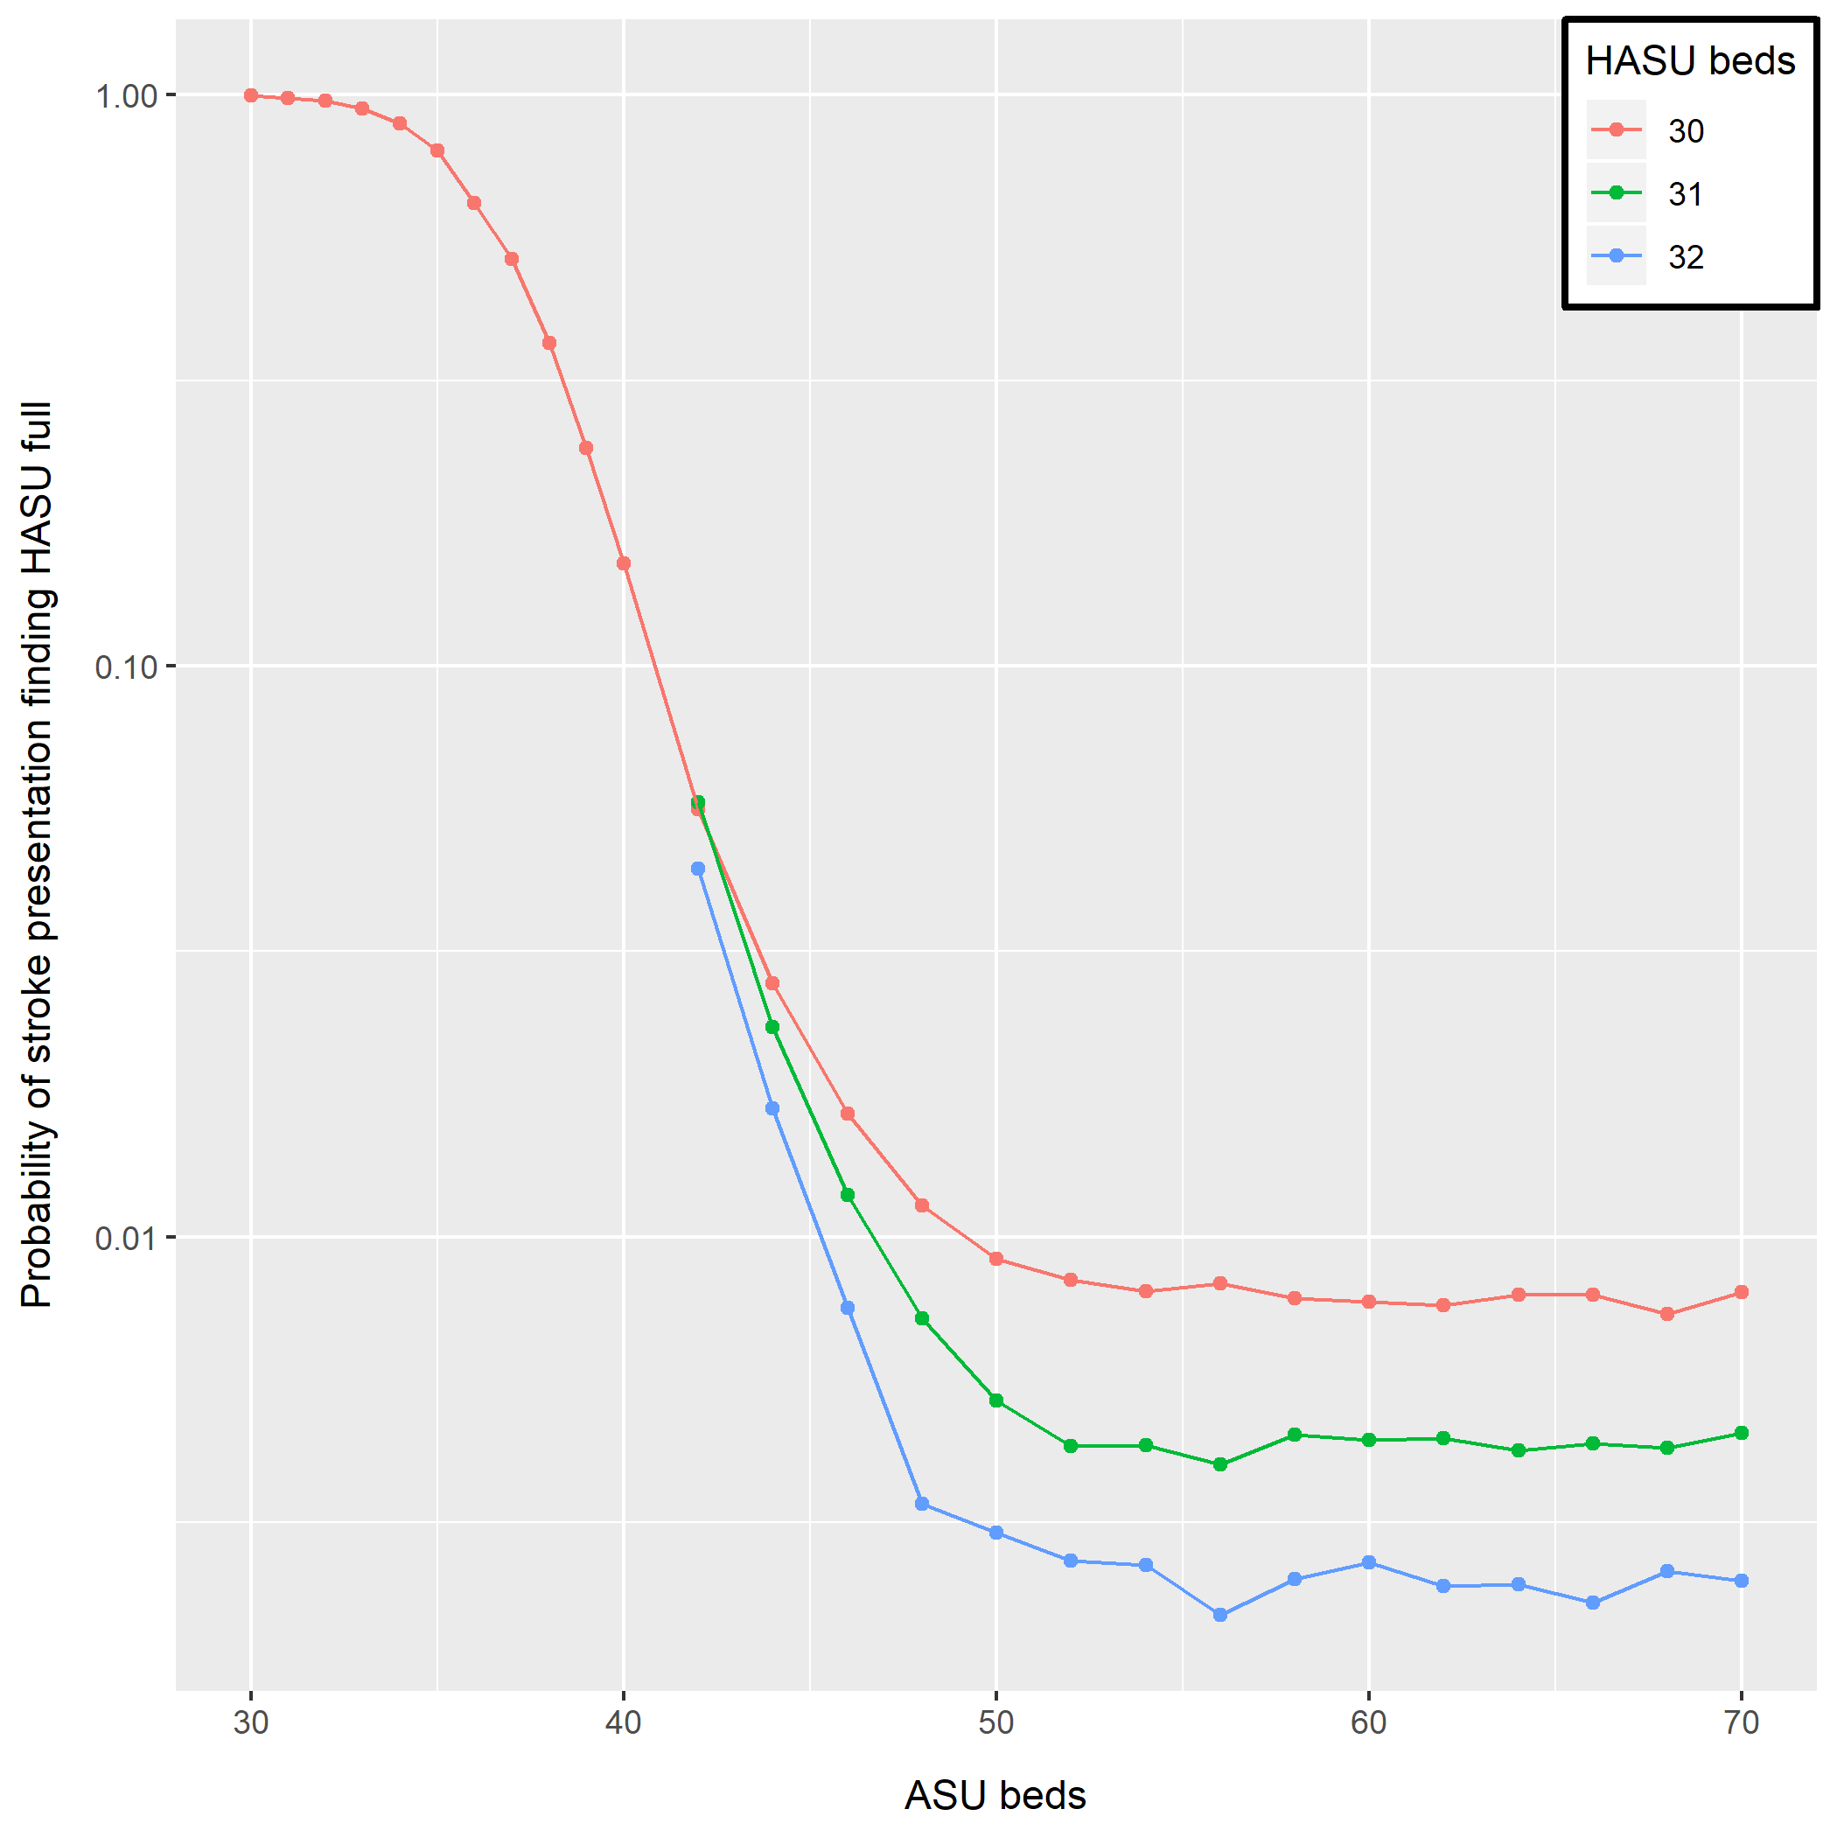
Modelling insights (1)
Bad
Diminishing returns with more ASU beds
Ultimate performance limited by HASU beds
Probability of arrival finding HASU full
30 HASU beds
31 HASU beds
Good
32 HASU beds
ASU beds

Slide 24
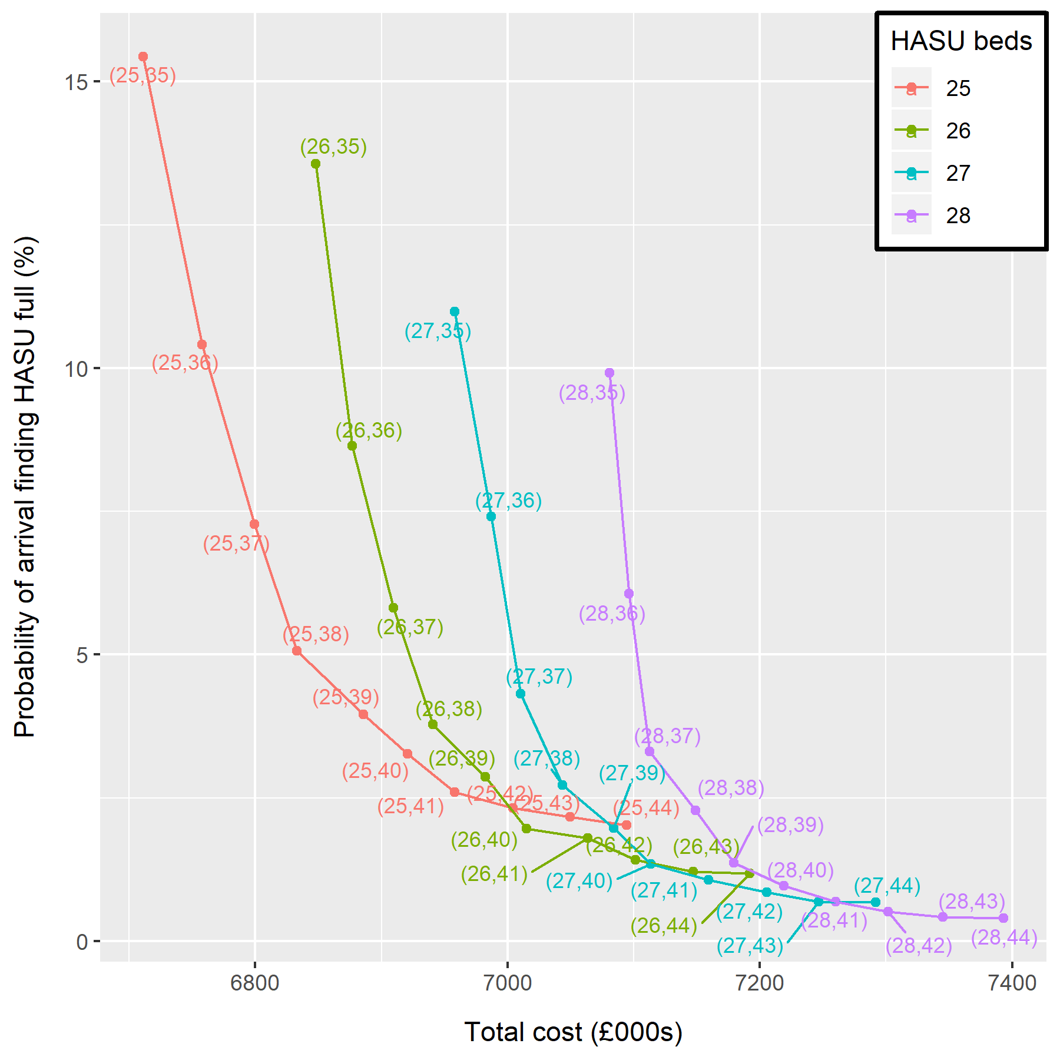
Modelling insights (2)
Pareto front
Less cost
% probability of arrival finding HASU full
Better performance
Possibility of divert/outlie
Total cost (£000s)
Workforce, beds, blockages

Slide 25
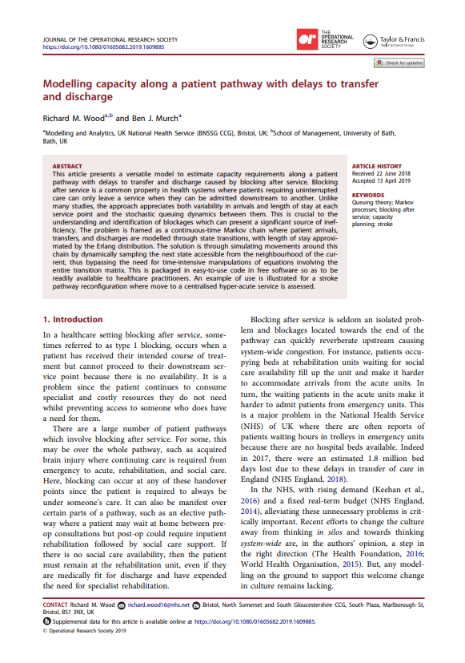
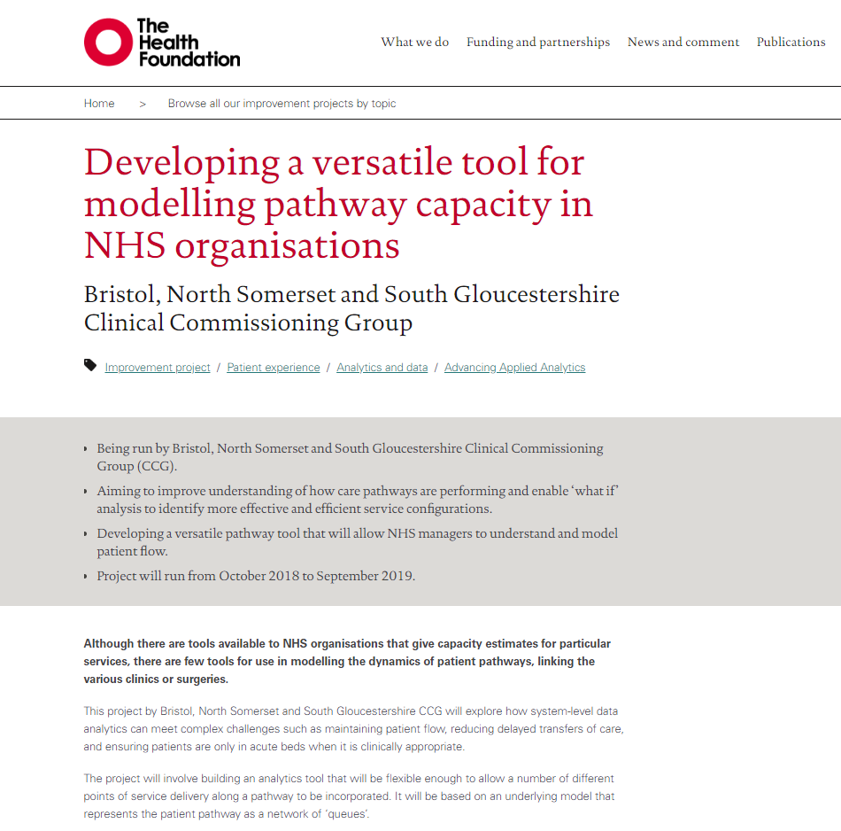
Further reading
Wood, R. M., & Murch, B. J. (2019). Modelling capacity along a patient pathway with delays to transfer and discharge. Journal of the Operational Research Society.
https://www.health.org.uk/improvement-projects/developing-a-versatile-tool-for-modelling-pathway-capacity-in-nhs-organisations

Slide 26



now available at:
PathSimR
github.com/nhs-bnssg-analytics
@BNSSGAnalytics
richard.wood16@nhs.net
ben.murch@nhs.net
cv280@bath.ac.uk
@ProfChristosV

